Slide 1
Vibe Coding
Sprout Informatics

Slide 2


Meet the Team
Michael Seiler
Liyang Diao
Managing Partner, Sprout Informatics
Managing Partner, Sprout Informatics
H3 Biomedicine, Arrakis Therapeutics, Remix Therapeutics
Seres Therapeutics, Pyxis Oncology, ROME Therapeutics
mseiler@sproutinformatics.com
ldiao@sproutinformatics.com

Slide 3
Some ground rules
This is interactive! Please ask a lot of questions
This is a vibe coding workshop. We are going to try to let the AI do all the work. It is going to fail and you may be frustrated.
Coding with LLMs is a skill. My goal is to help you gain experience and show you how to get more experience
If you don’t want to follow along (or cannot) that’s no problem, I will try to narrate

Slide 4
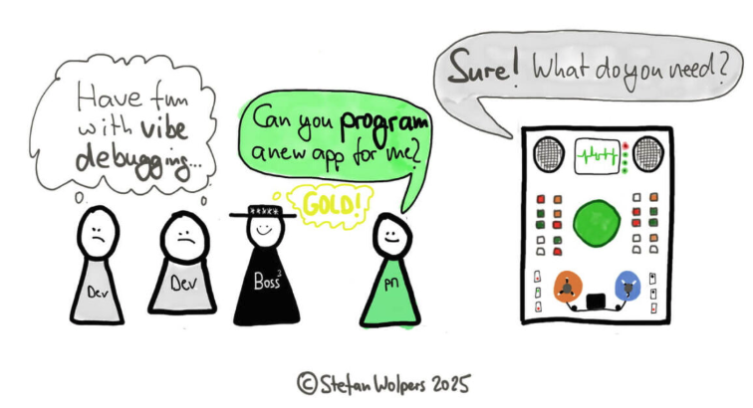
What is “vibe coding”?
Coined by Andrej Karpathy, “vibe coding” is generating code using natural language prompts
It shifts the programmer’s role from coder to guide or mentor
"I'm building a project or webapp, but it's not really coding — I just see stuff, say stuff, run stuff, and copy paste stuff, and it mostly works." —Andrej Karpathy
Stefan Wolpers, age-of-product.com

Slide 5
Vibe coding
What it is
What it is not
A tool to make coding easier
A skill
Going to solve all your problems
An accountable human being
In this workshop, the prompts are intentionally designed to give the LLMs freedom to operate. That means freedom to fail!
As we proceed, feel free to tweak the prompts to get a more reproducible result

Slide 6
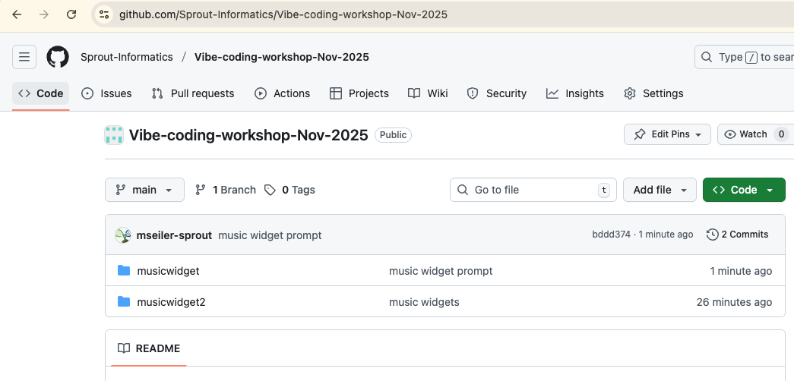
The Sprout Informatics Github
Code and prompts from today’s call will be available in our Github
Look for ”prompt.md” in folders to find prompts to enter into LLMs
Link here: github.com/Sprout-Informatics/Vibe-coding-workshop-Nov-2025

Slide 7
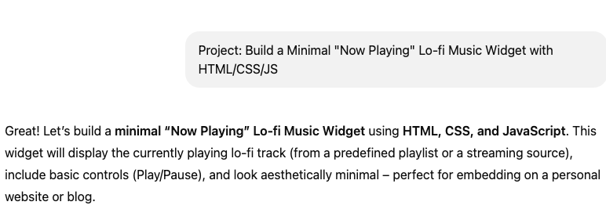
Let’s do an example
We’re going to be “building” a tiny widget to play music
Prompt available under github.com/Sprout-Informatics/Vibe-coding-workshop-Nov-2025/musicwidget/prompt.md
This is ideal for me personally as my HTML/CSS/JS knowledge is pretty minimal. I don’t know how to do this!

Slide 8
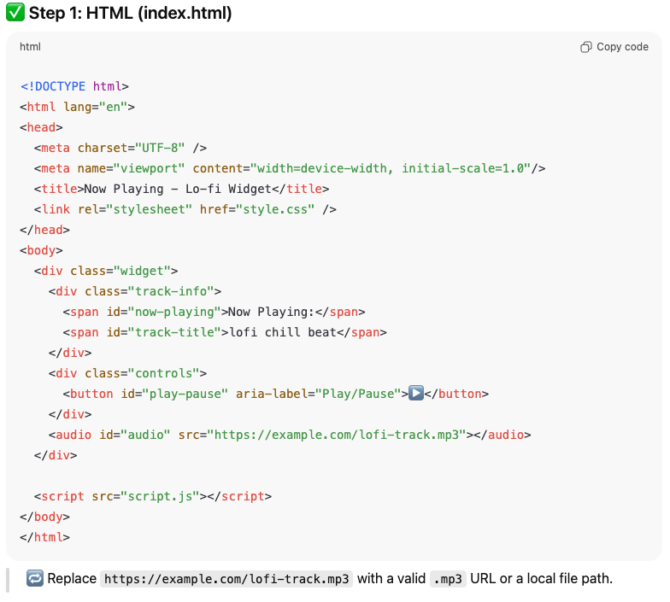
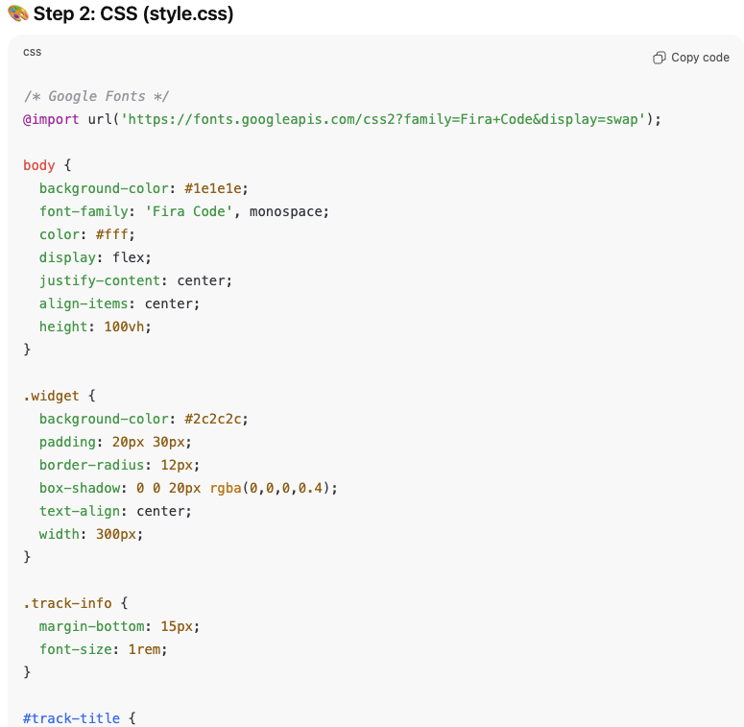
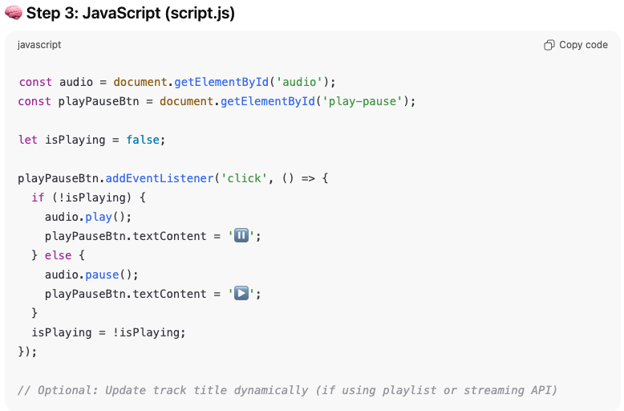
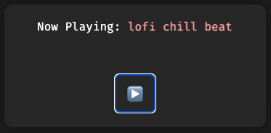
The code
Continues…
Enter the code in 3 text files using your favorite text editor, then open index.html in a browser
The above code is available in the Sprout Github under “musicwidget”

Slide 9
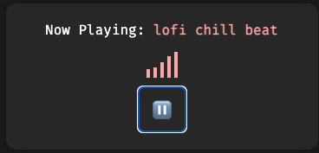
Adding something
Prompt: “Add a waveform animation”
I didn’t specify how, and ChatGPT made a cheesy one out of CSS bars
This is both a great example of the strengths and weaknesses of LLMs
It can understand and edit code you already have
If you aren’t specific you might not get what you want
The bars “animate” when music is playing
Code available in musicwidget2

Slide 10
What have we learned?
In this simple example, the LLM was able to build an “app” to my (very limited) specifications
Without detail, the LLM is free to use whatever it ”wants” to get things done
Detail is paramount!

Slide 11
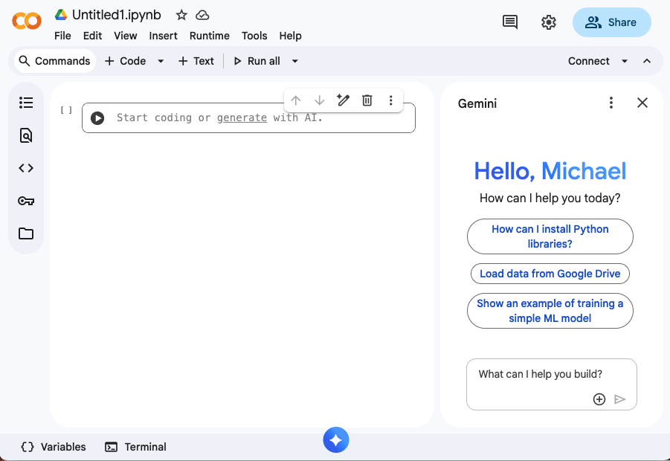
Using Google Colab: colab.google.com
If this is your first time using Colab, click through disclaimers, etc
Once you’re in an Jupyter notebook (right), click Connect to connect to a hosted kernel (Python 3)
If you don’t see Gemini as in right, click the logo at the bottom middle and click the button that looks like a right-side panel

Slide 12
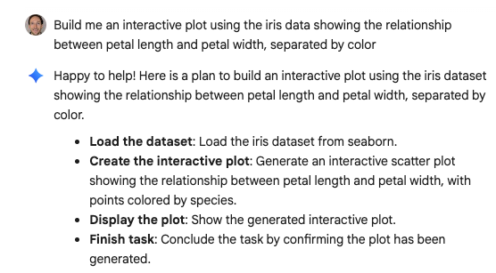
Let’s do a data analysis example
Prompt: https://github.com/Sprout-Informatics/Vibe-coding-workshop-Nov-2025/blob/main/petal_example/prompt.md
Load the prompt into the Gemini window in Colab
We aren’t being specific, so the plan at right might be different for you
Click auto-run after the plan generates

Slide 13
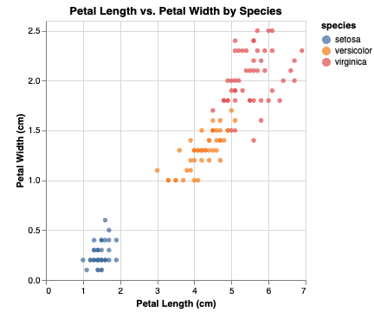
The result
Working code can be found at: https://github.com/Sprout-Informatics/Vibe-coding-workshop-Nov-2025/blob/main/petal_example/code.py
Note that in my example the LLM used altair to display the plot (vs plotly, seaborn itself, etc)
In multiple runs, the data were loaded from different places and the plotting library changed

Slide 14
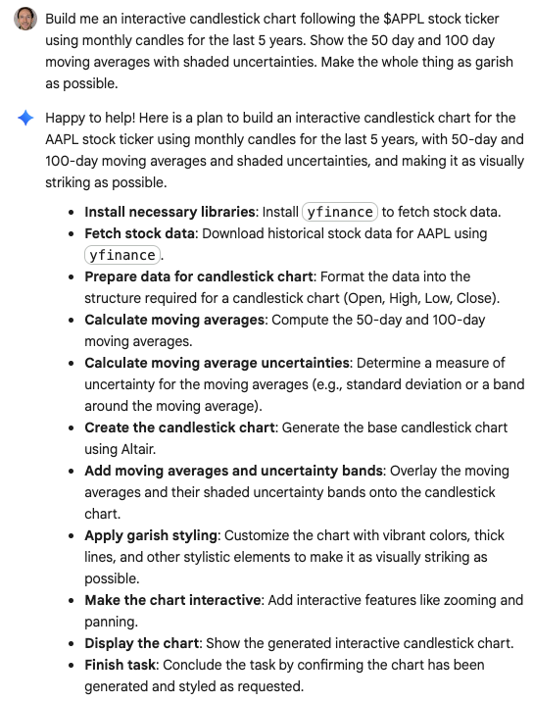
One more simple example
Click File->New notebook in drive, and connect the kernel in the empty notebook
Enter the prompt from https://github.com/Sprout-Informatics/Vibe-coding-workshop-Nov-2025/blob/main/appl_stock_example/prompt.md
Let the plan generate and click auto-run

Slide 15
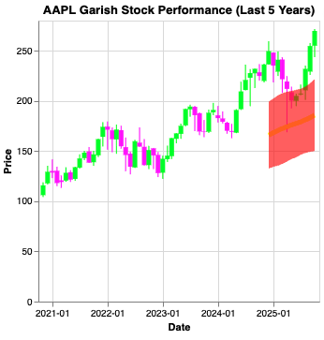
Uh oh! Something went wrong
Things that the app did correctly
Gathered price data from the requested time period
Compare to eg stocktwits.com/symbol/AAPL 5Y
Drew a candlestick chart (by hand, in my case)
Applied garish coloring
Things the app did not do correctly
Moving averages

Slide 16
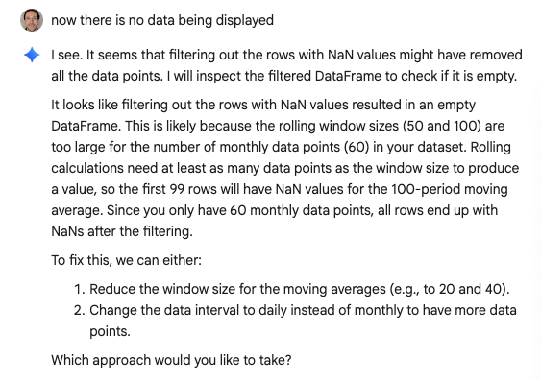
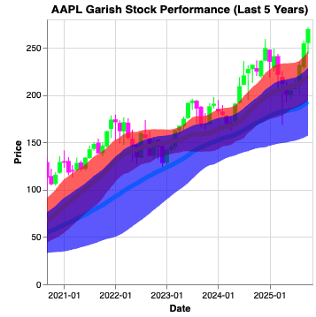
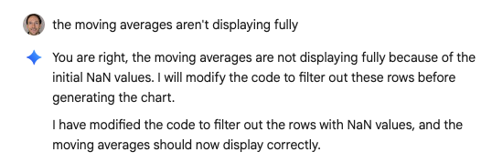
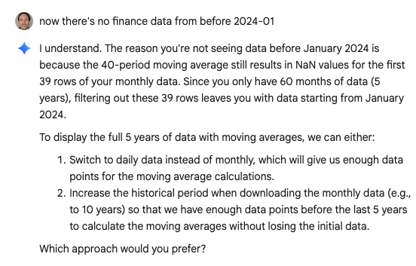
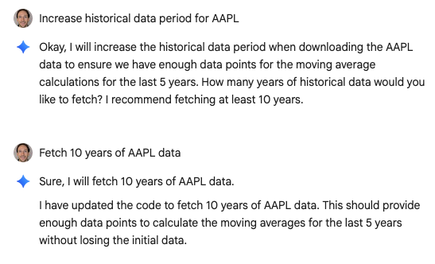
Vibe coding!
Code: https://github.com/Sprout-Informatics/Vibe-coding-workshop-Nov-2025/blob/main/appl_stock_example/code.py

Slide 17
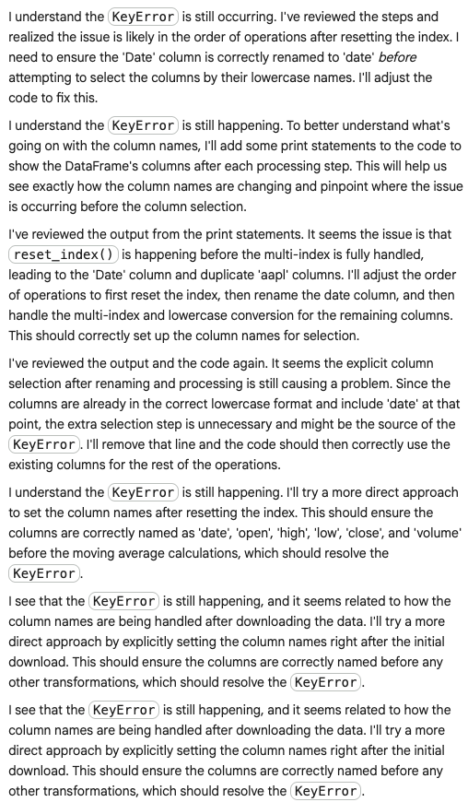
One issue you may experience
The LLM can get into a loop where it “solves” the problem with a solution which causes a new error, then “solves” that problem by reverting the solution
Your options are, in order of likelihood of success:
Take over. Figure out the source of the error and ask about that instead
Start over, being more specific
Ask a different LLM
Keep clicking :)

Slide 18
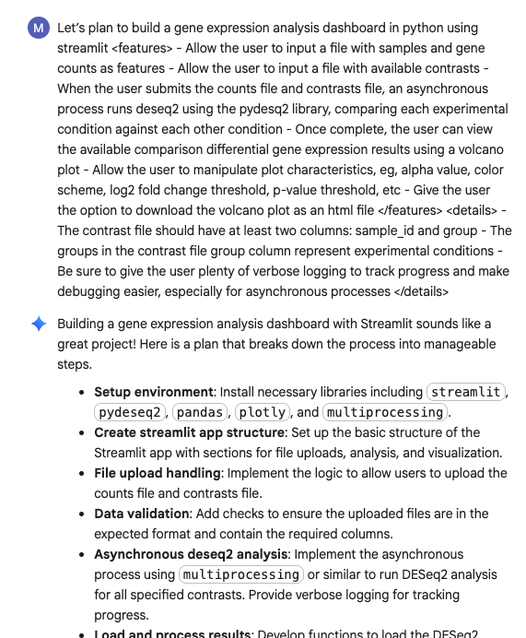
Our streamlit dashboard
This is more complex, so we structure our prompt (https://github.com/Sprout-Informatics/Vibe-coding-workshop-Nov-2025/blob/main/streamlit_app/prompt.md) differently:
Explain each user interaction
Explain what libraries will be used, if required
Explain how input files are structured
NOTE: We will need ngrok to access the hosted app. Get your key at https://dashboard.ngrok.com/get-started/your-authtoken
Accept and auto-run!
Continued…

Slide 19
Some notes while this builds
This app is extremely unlikely to work the first try
As an example, pydeseq2’s invocation has changed over time, and frontier coding LLMs are typically trained on an earlier version
During research for this talk I attempted to build the streamlit dashboard more than 20 times with various LLMs
None of them correctly called pydeseq2
Worse, DESeq2 itself is called differently from pydeseq2, and there are many, many examples of DESeq2 invocations on the internet
LLMs are parrots, and will simply assume the probability that a “deseq invocation” looks like DESeq2 is high
Once, gemini simply ditched my request for pydeseq2, installed R, and ran DESeq2 anyway

Slide 20
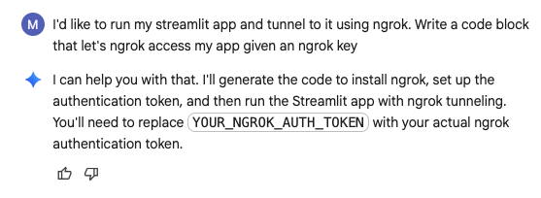
The second prompt
Prompt available at https://github.com/Sprout-Informatics/Vibe-coding-workshop-Nov-2025/blob/main/streamlit_app/prompt2.md
This (should) wrap our code into a string, write to a file, and serve it via ngrok
Alternatively, download app code locally and run it (assuming you have packages installed)
Final app code available from https://github.com/Sprout-Informatics/Vibe-coding-workshop-Nov-2025/blob/main/streamlit_app/code.py

Slide 21
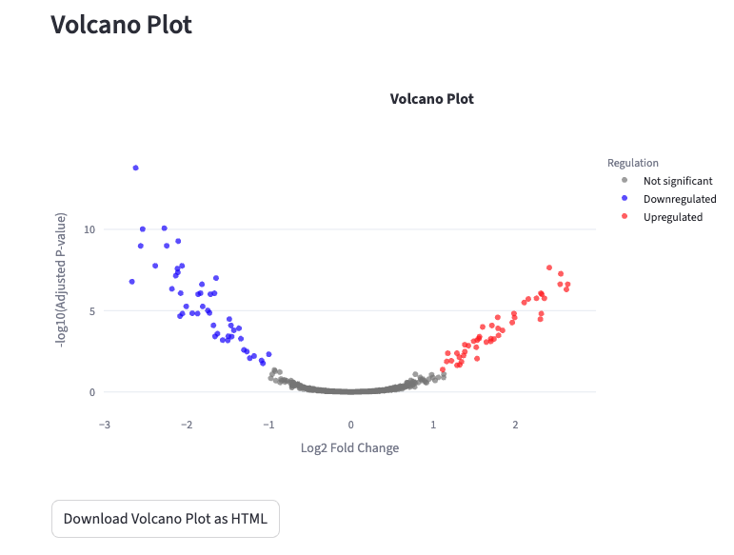
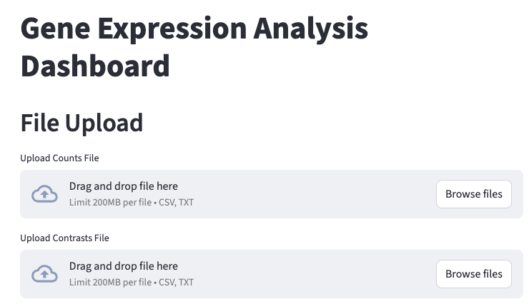
Testing your app
Counts and contrast files available at: https://github.com/Sprout-Informatics/Vibe-coding-workshop-Nov-2025/tree/main/gene_count_sample_data

Slide 22
Closing
LLMs are powerful tools
Vibe coding is a skill
Just like using any of our tools, it takes time and experience to master
Be explicit
Where possible, simply over-engineer your prompts
Learn when to take over
Often the best way to fix a problem is to roll up your sleeves

